Slide 1
Digital Portfolio
STUDENT NAME: S. JANANI
REGISTER NO AND NMID: 24132231802522025 AND 6DB0A9639168C89A7D4456C4BA88CF9D
DEPARTMENT: B. S., COMPUTER SCIENCE
COLLEGE: DR. MGR GOVERNMENT ARTS AND SCIENCE COLLEGE FOR WOMEN/ANNAMALAI UNIVERSITY

Slide 2
PROJECT TITLE
Student Portfolio Website
Student Portfolio

Slide 3


AGENDA
Problem Statement
Project Overview
End Users
Tools and Technologies
Portfolio design and Layout
Features and Functionality
Results and Screenshots
Conclusion
Github Link
3/21/2024 Annual Review

Slide 4

PROBLEM STATEMENT
Students often struggle to showcase their skills, projects, and achievements in an organized and professional way. Traditional resumes are static and lack interactivity. A personal portfolio website provides an engaging platform for students to present their abilities, academic background, and projects effectively to recruiters, teachers, and peers."

Slide 5

PROJECT OVERVIEW
The Student Portfolio Website is a personal web-based platform created using HTML, CSS, and JavaScript. It allows students to showcase their profile, skills, academic background, and projects in an interactive and visually appealing way. The portfolio includes sections like About Me, Skills, Projects, Education, and Contact Information.

Slide 6

WHO ARE THE END USERS?
Students → to showcase their skills, education, and projects. Recruiters / Employers → to review student profiles for jobs or internships. Teachers / Mentors → to evaluate student work and achievements. Peers & General Audience → to explore the student’s portfolio and collaborations.

Slide 7

TOOLS AND TECHNIQUES
HTML5 → Structure of the website CSS3 → Styling and responsive design JavaScript → Interactivity (smooth scrolling, form validation) Code Editor → VS Code / Sublime Text Browser → Chrome / Edge / Firefox for testing

Slide 8
POTFOLIO DESIGN AND LAYOUT
Header Section → Name, role, and navigation menu About Me → Short introduction with background info Skills Section → List of technical & soft skills Projects Section → Cards showcasing student projects
8

Slide 9
FEATURES AND FUNCTIONALITY
About Me → Displays student introduction and profile. Skills Section → Highlights technical and soft skills. Projects Showcase → Shows completed academic/personal projects. Education Details → Lists academic qualifications.

Slide 10
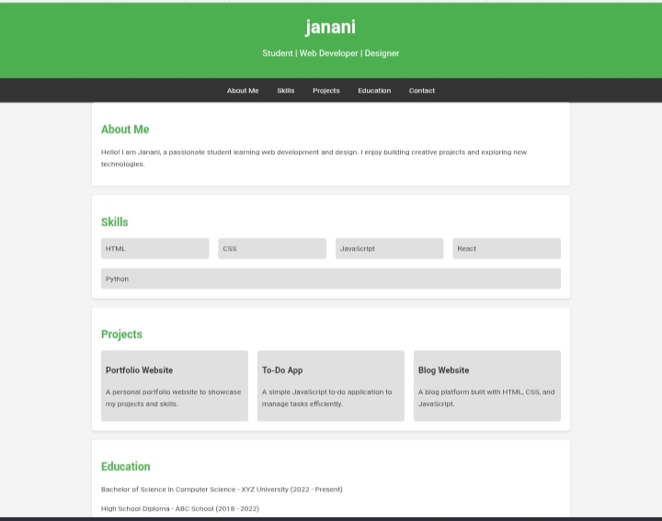

RESULTS AND SCREENSHOTS
3/21/2024 Annual Review
10

Slide 11
CONCLUSION
The Student Portfolio Website provides a professional platform for students to showcase their skills, projects, and education. It is built using HTML, CSS, and JavaScript, ensuring a clean design and interactivity.
11

